Slide 1
Machine Learning for Neuroscience
Applications in neuroscience and neuroscience inspired models
Payam Barnaghi
Department of Brain Sciences
Imperial College London
January 2023
Notes:
1

Slide 2
Neuroscience and AI
Neuroscience provides a rich source of inspiration for new types of algorithms and architectures.
This is often independent of and complementary to the mathematical and logic-based methods and ideas that have largely dominated traditional approaches to AI.
Source: Hassabis D, Kumaran D, Summerfield C, Botvinick M. Neuroscience-Inspired Artificial Intelligence. Neuron. 2017

Slide 3
Neuroscience in ML
Neuroscience could help to provide a systems neuroscience-level view of the brain.
It can help to view the network, architecture, functions, and representations that the brain utilises.
The precise mechanisms by which the processes/interactions are physically realised in a biological substrate are often less relevant at the implementation level (of AI models).
Source: Hassabis D, Kumaran D, Summerfield C, Botvinick M. Neuroscience-Inspired Artificial Intelligence. Neuron. 2017

Slide 4
Transferrable ideas from neuroscience
By focusing on the computational and algorithmic levels, we can obtain transferrable insights into general mechanisms of brain function while leaving room to accommodate the distinctive opportunities and challenges that arise when building intelligent machines in silico.
Source: Hassabis D, Kumaran D, Summerfield C, Botvinick M. Neuroscience-Inspired Artificial Intelligence. Neuron. 2017

Slide 5
Deep learning
For example, biological considerations informed the development of successful regularisation schemes that support generalisation beyond training data.
One such scheme, in which only a subset of units participate in the processing of a given training example (‘‘dropout’’), was motivated by the stochasticity that is inherent in biological systems populated by neurons that fire with Poisson-like statistics (Hinton et al., 2012).
Source: Hassabis D, Kumaran D, Summerfield C, Botvinick M. Neuroscience-Inspired Artificial Intelligence. Neuron. 2017

Slide 6
Deep learning and biological systems
In both biological and artificial systems, successive non-linear computations transform raw visual input into an increasingly complex set of features, permitting object recognition that is invariant to transformations of pose, illumination, or scale.
Source: Hassabis D, Kumaran D, Summerfield C, Botvinick M. Neuroscience-Inspired Artificial Intelligence. Neuron. 2017

Slide 7
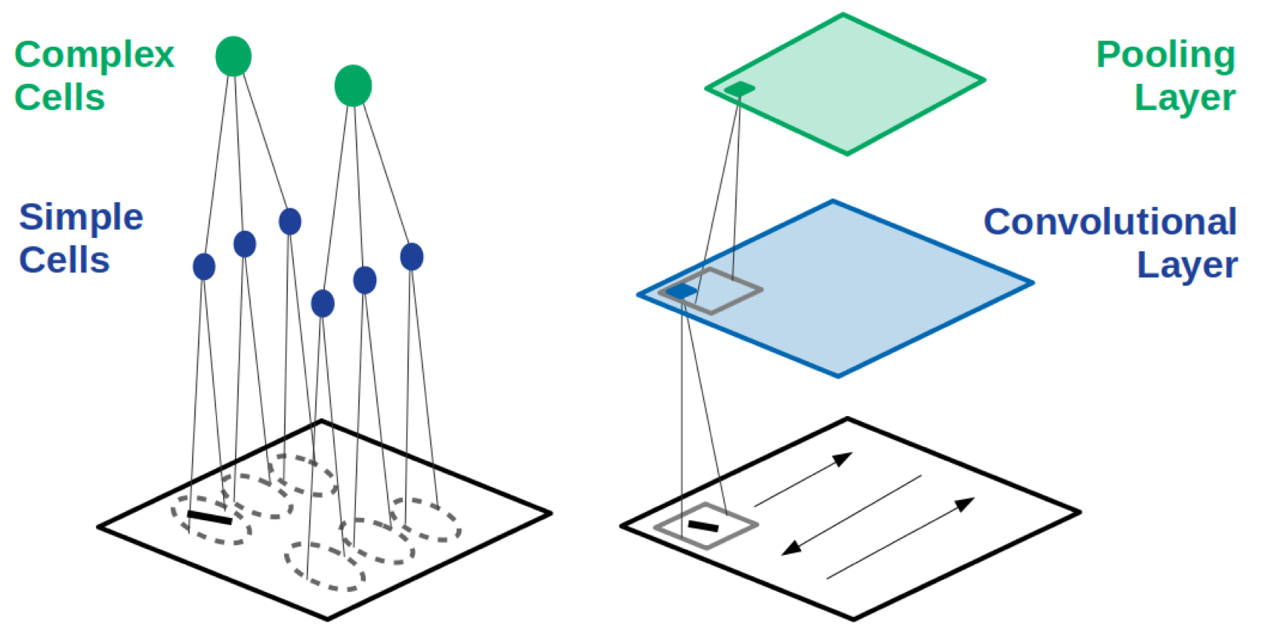
CCNs and visual cortex
Hubel and Wiesel discovered that simple cells (left, blue) have preferred locations in the image (dashed ovals) wherein they respond most strongly to bars of particular orientation. Complex cells (green) receive input from many simple cells and thus have more spatially invariant responses.
Source: Grace W. Lindsay, Gatsby Unit, UCL, https://arxiv.org/pdf/2001.07092.pdf

Slide 8
Reinforcement learning
Reinforcement learning methods address the problem of how to maximise future reward by mapping states in the environment to actions and are among the most widely used tools in AI research (Sutton and Barto, 1998).
RL methods were originally inspired by research into animal learning. In particular, the development of temporal-difference (TD) methods, a critical component of many RL models, was inextricably intertwined with research into animal behaviour in conditioning experiments.
Source: Hassabis D, Kumaran D, Summerfield C, Botvinick M. Neuroscience-Inspired Artificial Intelligence. Neuron. 2017

Slide 9
Reinforcement learning
Examples of neuroscience-informed RL models include TD methods and related techniques have gone on to supply the core technology for recent advances in AI, ranging from robotic control (Hafner and Riedmiller, 2011) to expert play in backgammon (Tesauro, 1995) and Go (Silver et al., 2016).
Source: Hassabis D, Kumaran D, Summerfield C, Botvinick M. Neuroscience-Inspired Artificial Intelligence. Neuron. 2017

Slide 10
Attention-based models
The brain does not learn by implementing a single, global optimisation principle within a uniform and undifferentiated neural network (Marblestone et al., 2016).
Biological brains are modular, with distinct but interacting subsystems underpinning key functions such as memory, language, and cognitive control (Anderson et al., 2004; Shallice, 1988).
One illustrative example is recent AI work on attention. Up until quite lately, most CNN models worked directly on entire images or video frames, with equal priority given to all image pixels at the earliest stage of processing. The primate visual system works differently.
Source: Hassabis D, Kumaran D, Summerfield C, Botvinick M. Neuroscience-Inspired Artificial Intelligence. Neuron. 2017

Slide 11
CNNs and attention
Rather than processing all input in parallel, visual attention shifts strategically among locations and objects, centering processing resources and representational coordinates on a series of regions in turn (Koch and Ullman, 1985; Moore and Zirnsak, 2017; Posner and Petersen, 1990).
Detailed neurocomputational models have shown how this piecemeal approach benefits behaviour, by prioritizing and isolating the information that is relevant at any given moment (Olshausen et al., 1993; Salinas and Abbott, 1997).
One such network was able to use this selective attentional mechanism to ignore irrelevant objects in a scene, allowing it to perform well in challenging object classification tasks in the presence of clutter (Mnih et al., 2014).
Source: Hassabis D, Kumaran D, Summerfield C, Botvinick M. Neuroscience-Inspired Artificial Intelligence. Neuron. 2017

Slide 12
Working memory
Human intelligence is characterized by a remarkable ability to maintain and manipulate information within an active store, known as working memory, which is thought to be instantiated within the prefrontal cortex and interconnected areas (Goldman-Rakic, 1990).
Classic cognitive theories suggest that this functionality depends on interactions between a central controller (‘‘executive’’) and separate, domain-specific memory buffers (e.g., visuo-spatial sketchpad) (Baddeley, 2012).
Source: Hassabis D, Kumaran D, Summerfield C, Botvinick M. Neuroscience-Inspired Artificial Intelligence. Neuron. 2017

Slide 13
Continual learning
Intelligent agents must be able to learn and remember many different tasks that are encountered over multiple timescales.
Both biological and artificial agents must thus have a capacity for continual learning, that is, an ability to master new tasks without forgetting how to perform prior tasks (Thrun and Mitchell,1995). While animals appear relatively adept at continual learning, neural networks suffer from the problem of catastrophic forgetting (French, 1999; McClelland et al., 1995).
Source: Hassabis D, Kumaran D, Summerfield C, Botvinick M. Neuroscience-Inspired Artificial Intelligence. Neuron. 2017

Slide 14
Neuroimaging and continual learning
In neuroscience, advanced neuroimaging techniques (e.g., two-photon imaging) now allow dynamic in vivo visualization of the structure and function of dendritic spines during learning, at the spatial scale of single synapses (Nishiyama and Yasuda, 2015).
This approach can be used to study neocortical plasticity during continual learning (Cichon and Gan, 2015; Hayashi-Takagi et al., 2015; Yang et al., 2009).
Source: Hassabis D, Kumaran D, Summerfield C, Botvinick M. Neuroscience-Inspired Artificial Intelligence. Neuron. 2017

Slide 15
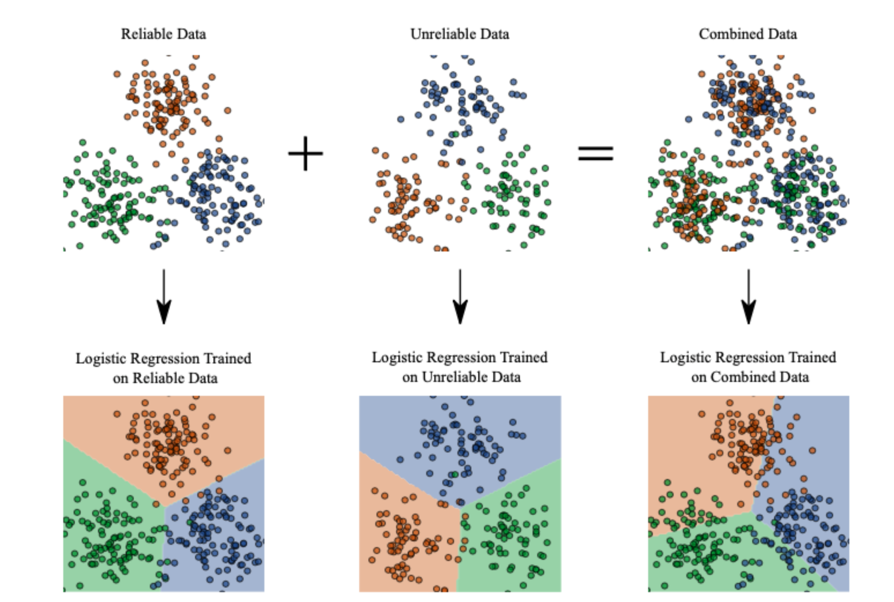
Neuroplasticity and machine learning models
A. Capstick, F. Palermo, P Barnaghi, https://arxiv.org/pdf/2212.02895.pdf
https://github.com/alexcapstick/LossAdaptedPlasticity

Slide 16
AI in neuroscience
Neuroimaging data analysis
Behaviour and large population data analysis
Computational models and simulations
Graph and network analysis
Fusion models and multimodal models for predictions/risk assessments
An interesting read, How AI and neuroscience drive each other, https://www.nature.com/articles/d41586-019-02212-4

Slide 17
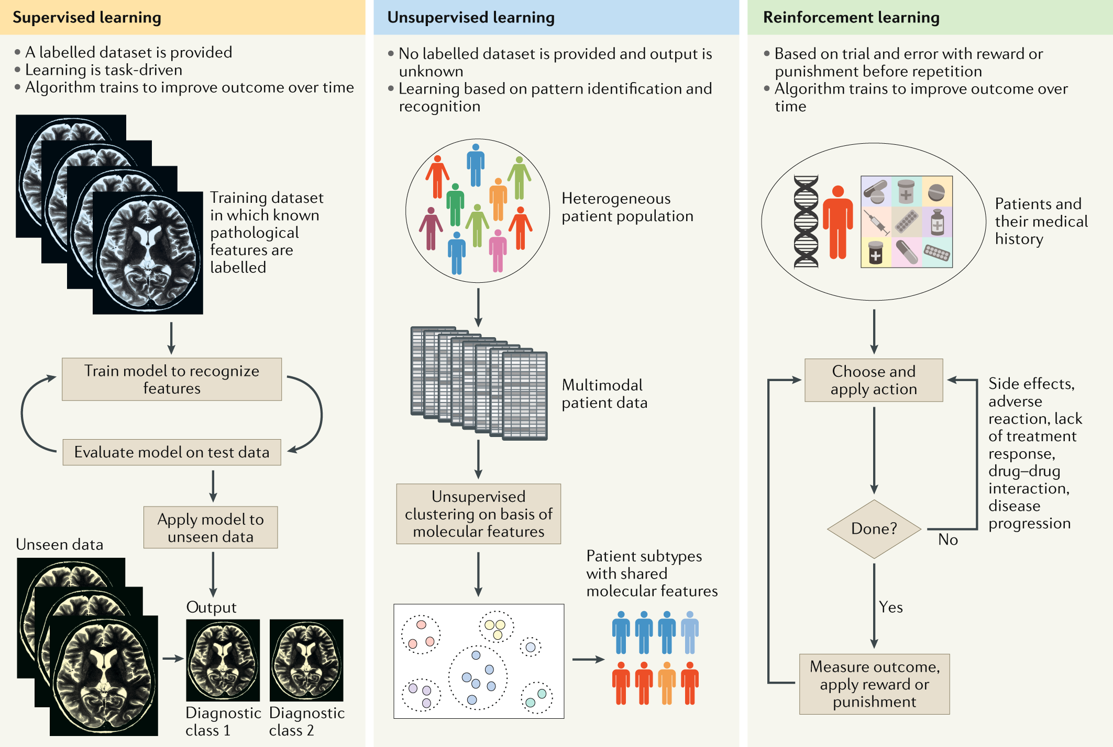
Applications of ML to diagnosis and treatment of neurodegenerative diseases
Source : Myszczynska, M.A., Ojamies, P.N., Lacoste, A.M.B. et al. Applications of machine learning to diagnosis and treatment of neurodegenerative diseases. Nat Rev Neurol16, 440–456 (2020).

Slide 18
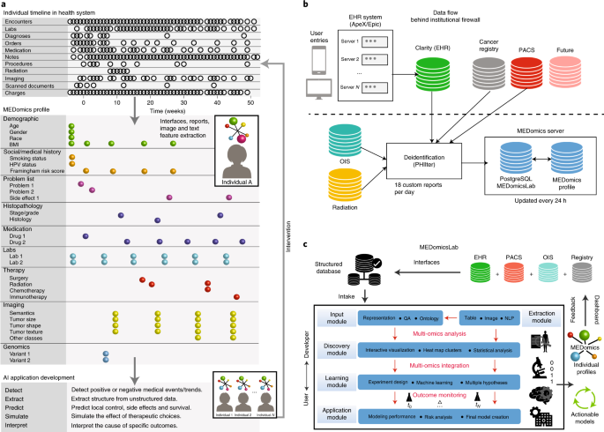
ML and electronic healthcare records analysis
Source: Morin, O., Vallières, M., Braunstein, S. et al. An artificial intelligence framework integrating longitudinal electronic health records with real-world data enables continuous pan-cancer prognostication. Nat Cancer 2, 709–722 (2021). https://doi.org/10.1038/s43018-021-00236-2

Slide 19
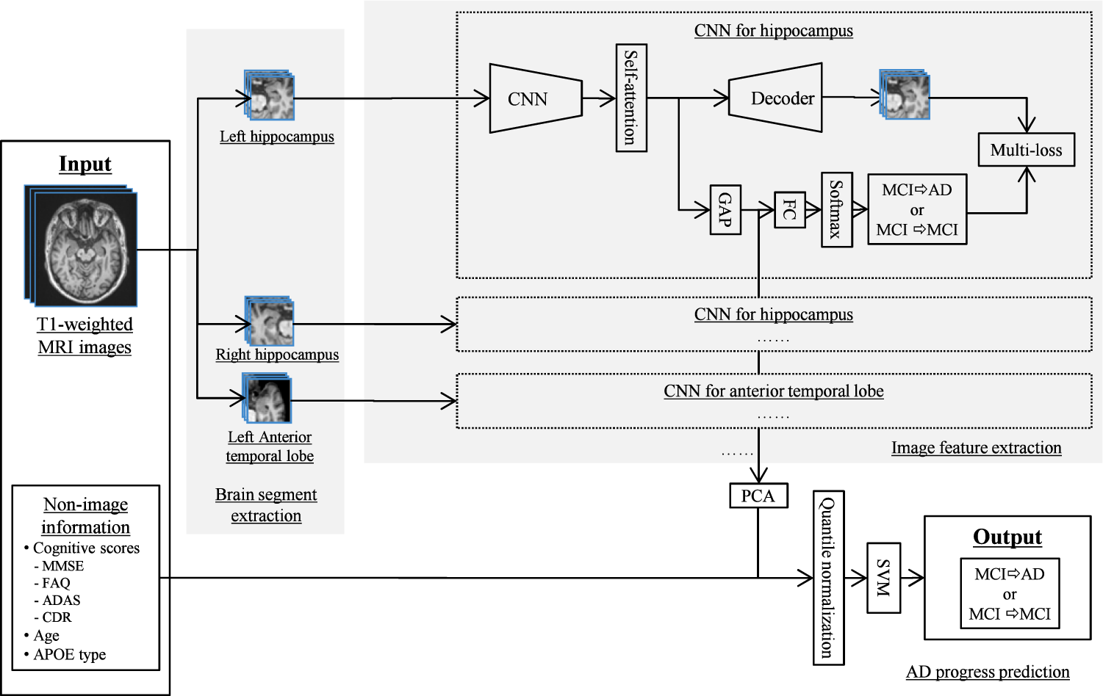
ML for predicting the progression of disease
Wang, C., Li, Y., Tsuboshita, Y. et al. A high-generalizability machine learning framework for predicting the progression of Alzheimer’s disease using limited data.npj Digit. Med. 5, 43 (2022).

Slide 20
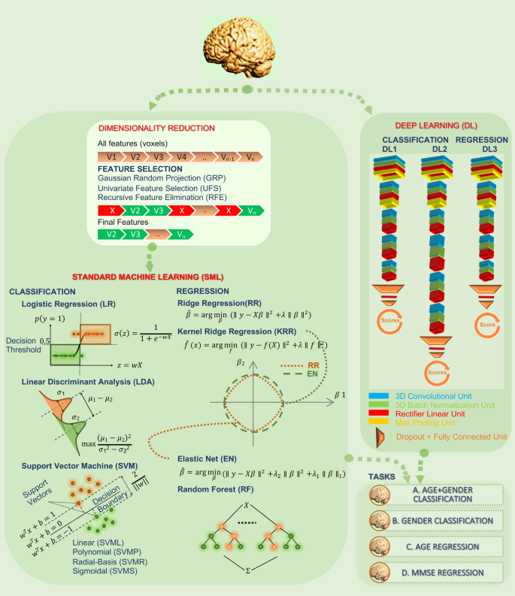
Neuroimaging and deep learning
Source: Abrol, A., Fu, Z., Salman, M. et al. Deep learning encodes robust discriminative neuroimaging representations to outperform standard machine learning. Nat Commun 12, 353 (2021).

Slide 21
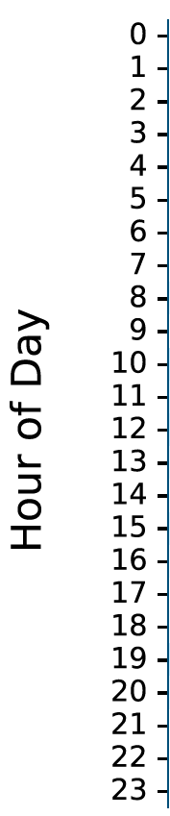
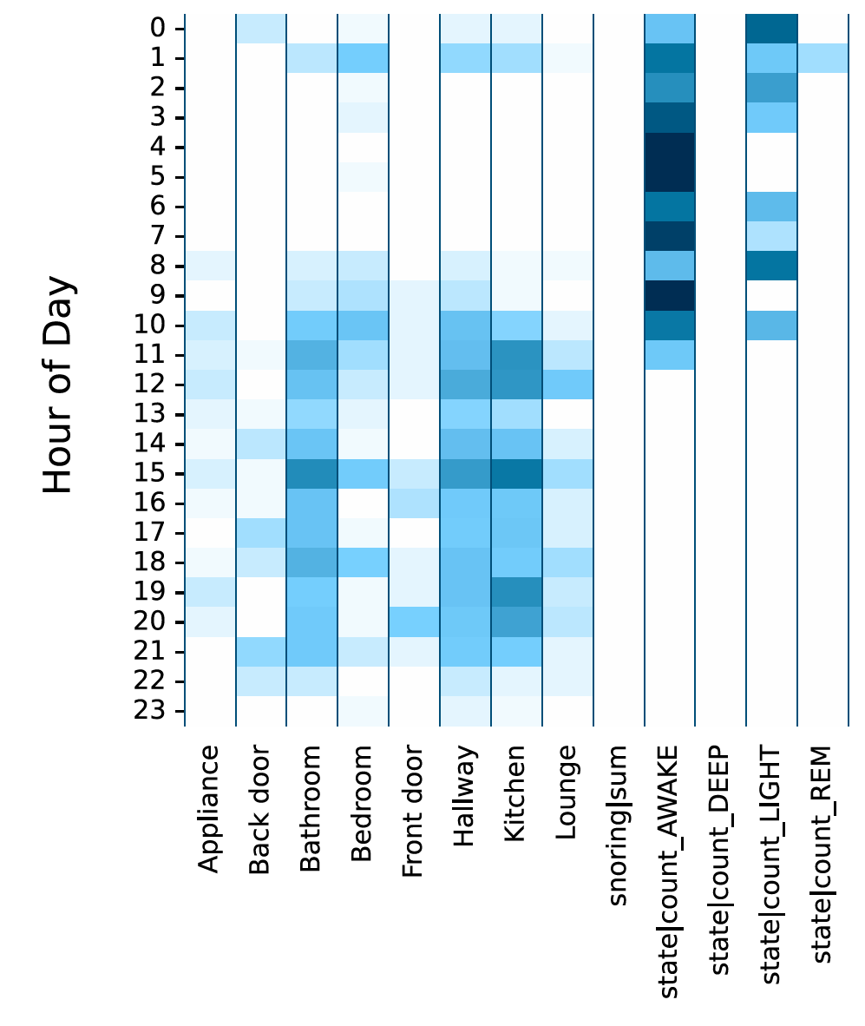


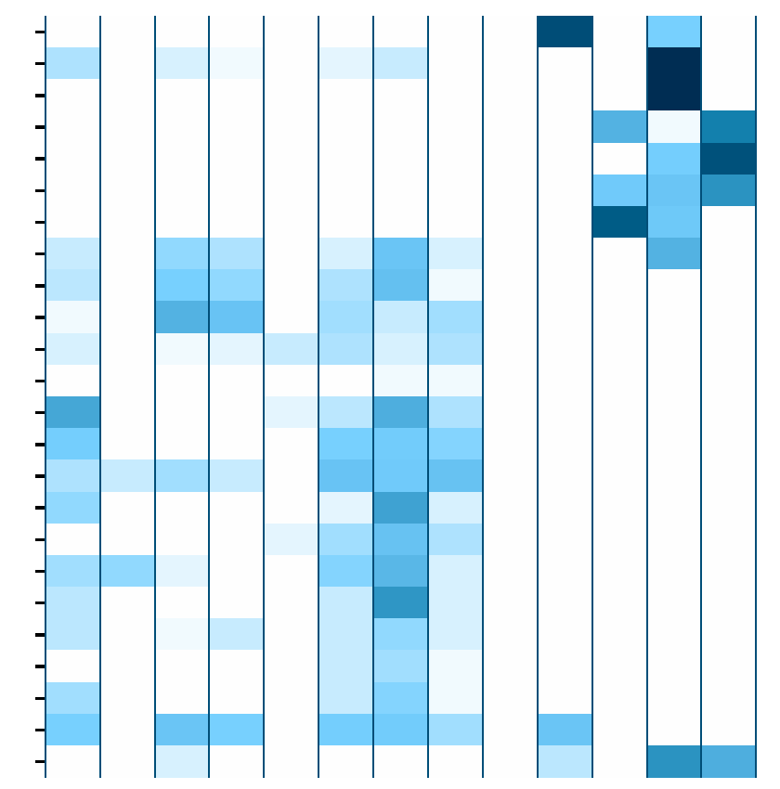
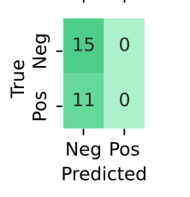
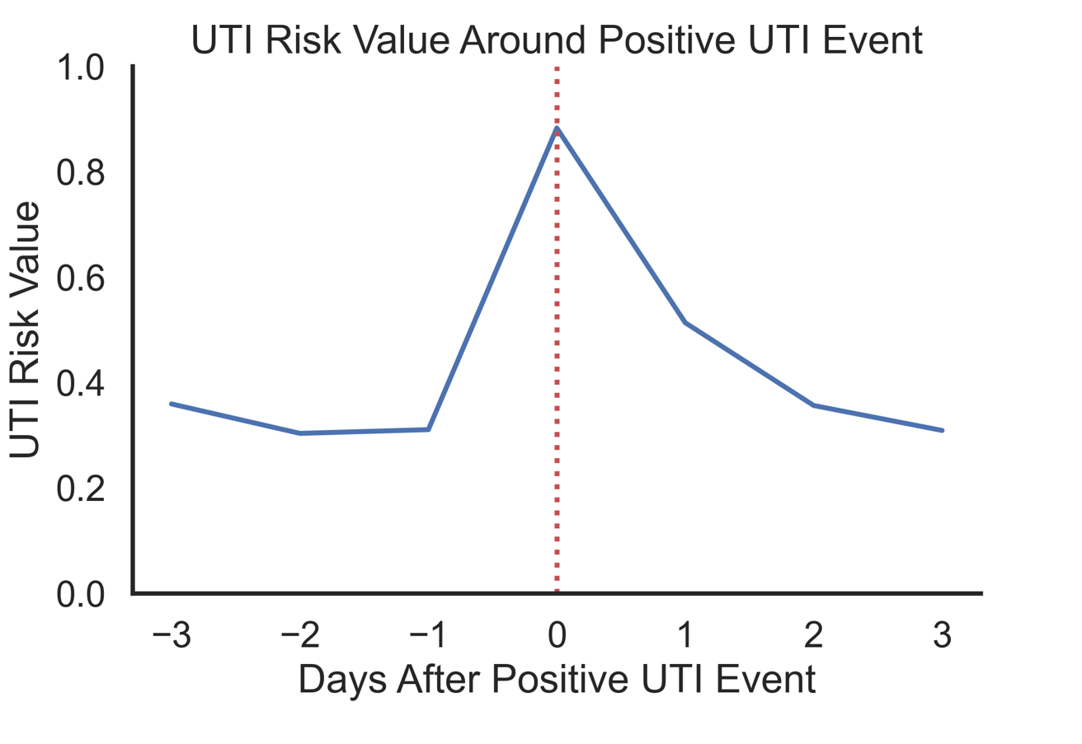
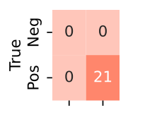
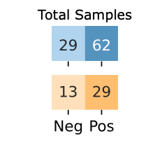
ML in precision health and care
UTIs are one of the top 5 reasons on unplanned hospital admissions in People Living with Dementia. UTI symptoms include increase in frequency of going to bathroom, delirium, increased temperature.
The model uses 20,738 person-days of in-home monitoring data which consists sleep, movement, and physiology data collected within the UK DRI CR&T study cohort (n=108) between 06/2021-07/2022.
(Alex Capstick and Francesca Palermo et al.)

Slide 22
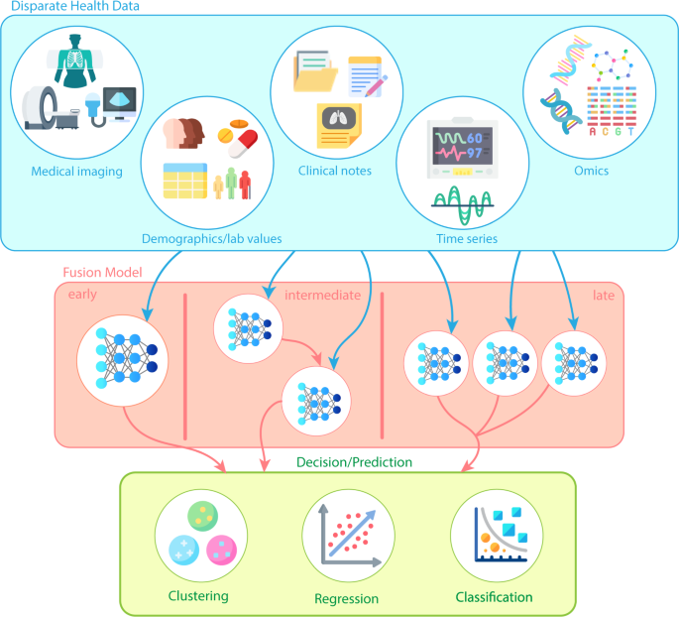
Applications at different stages
Source: Kline, A., Wang, H., Li, Y. et al. Multimodal machine learning in precision health: A scoping review. npj Digit. Med. 5, 171 (2022). https://doi.org/10.1038/s41746-022-00712-8

Slide 23
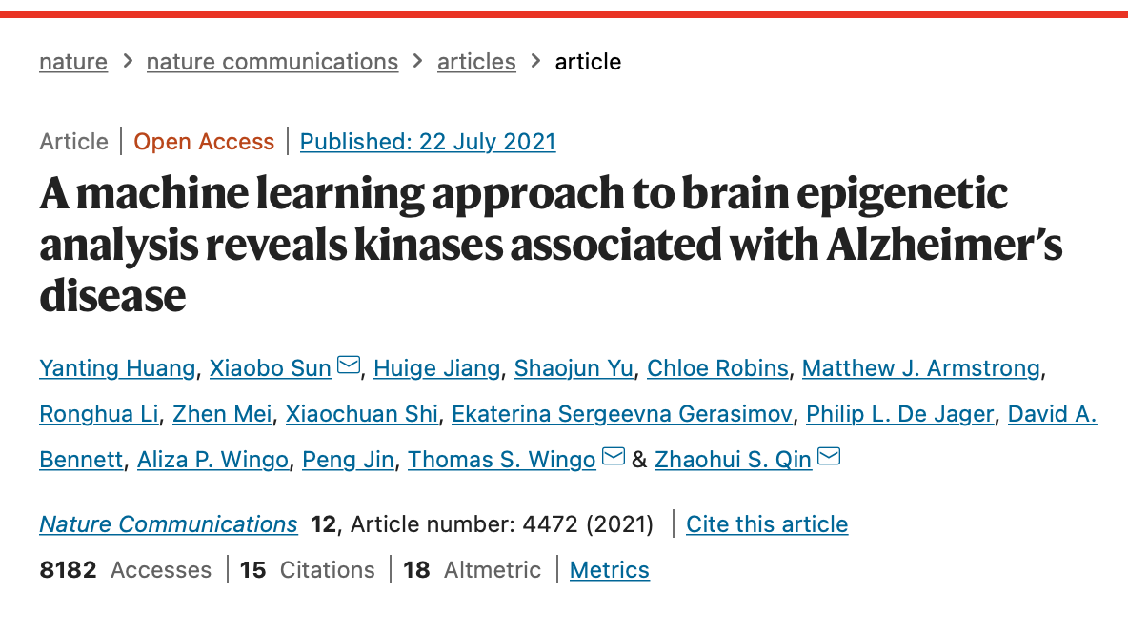
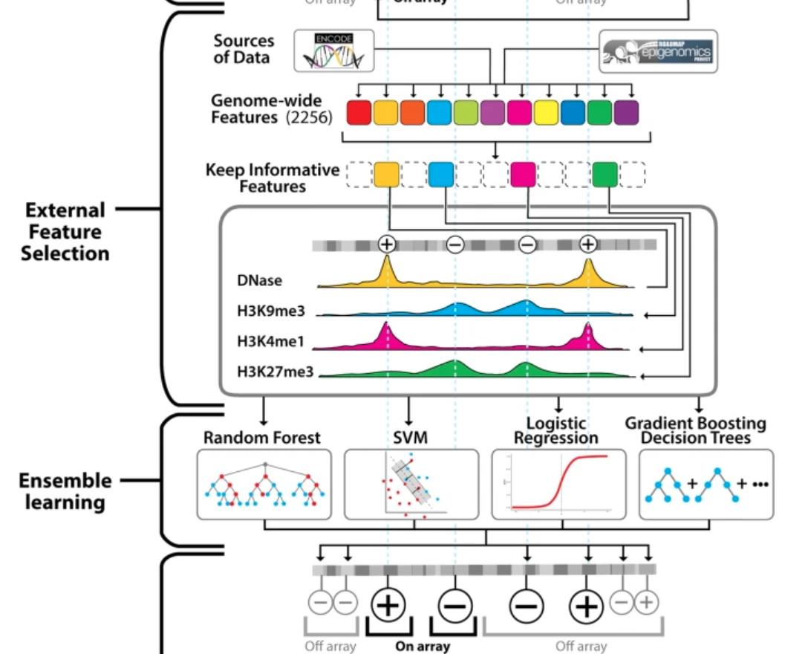
ML applied to brain epigenetic data

Slide 24
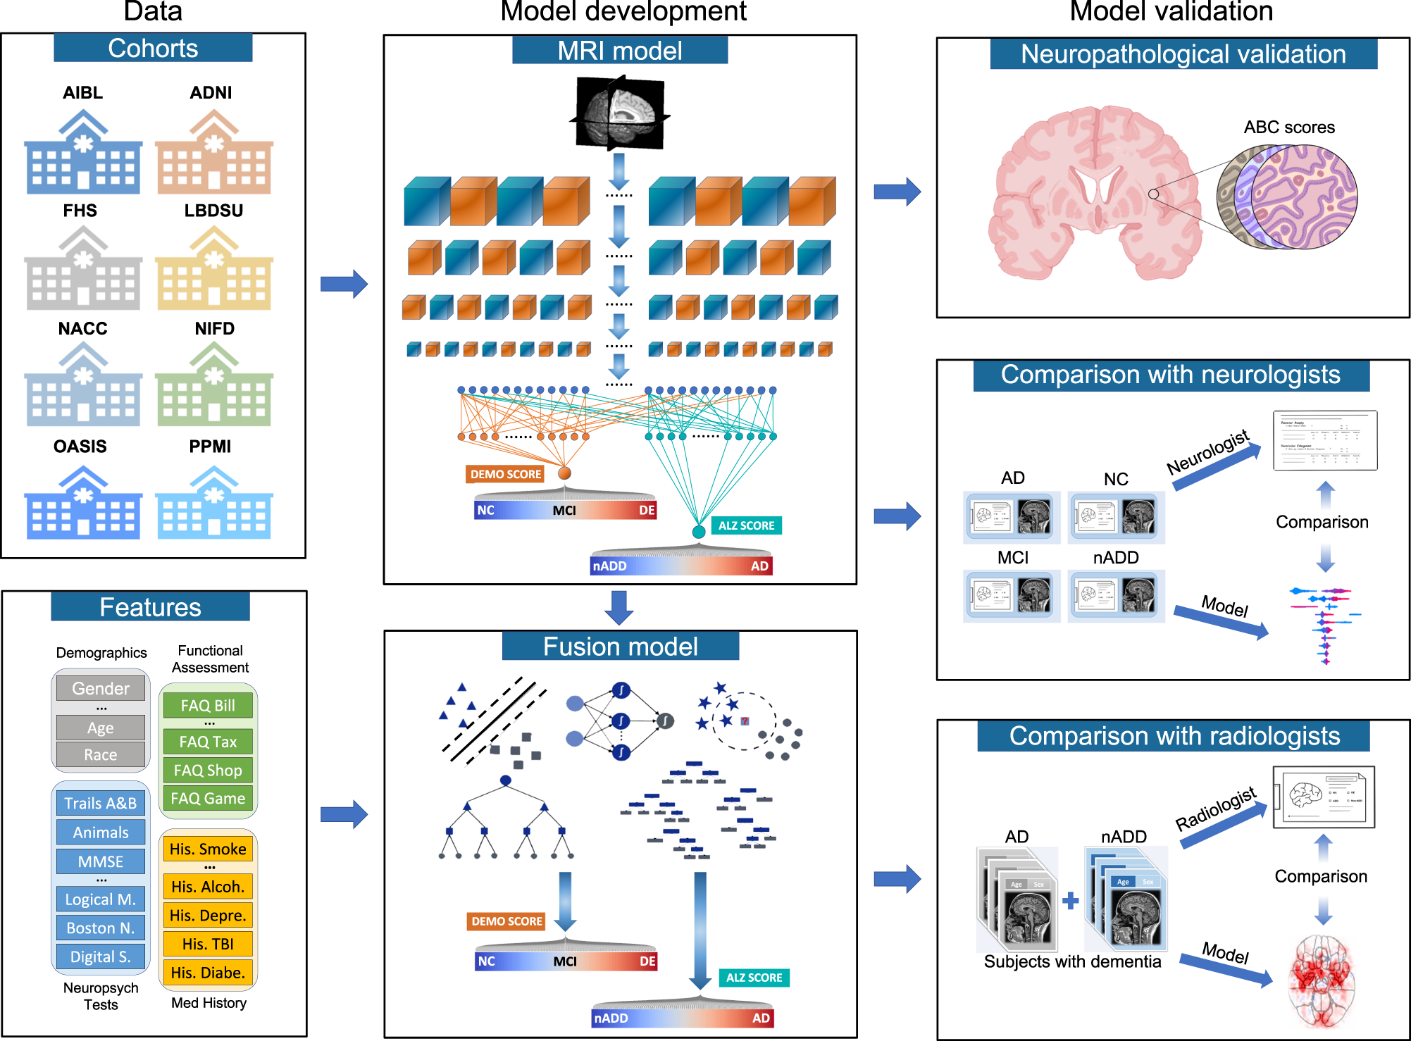
Multimodal data assessment
Qiu, S., Miller, M.I., Joshi, P.S. et al. Multimodal deep learning for Alzheimer’s disease dementia assessment. Nat Commun 13, 3404 (2022).

Slide 25
Practical methodology

Slide 26
Principal component analysis (PCA)
PCA is used to decompose a multivariate dataset in a set of successive orthogonal components that explain a maximum amount of the variance.
In scikit-learn, PCA is implemented as a transformer object that learns n components in its fit method, and can be used on new data to project it on these components.
Source: George Dallas, Principal Component Analysis 4 Dummies: Eigenvectors, Eigenvalues and Dimension Reduction.

Slide 27
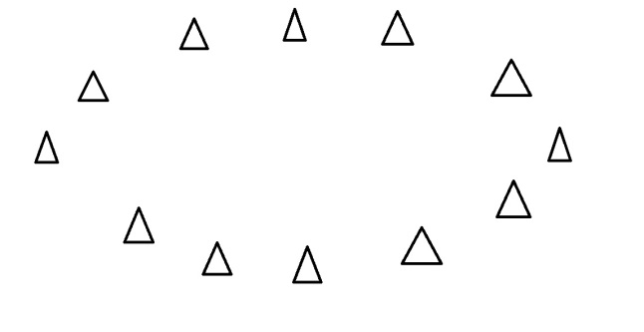
What are principal components?
They are the underlying structure in the data.
They are the directions where there is the most variance, the directions where the data is most spread out.
Source: George Dallas, Principal Component Analysis 4 Dummies: Eigenvectors, Eigenvalues and Dimension Reduction.

Slide 28
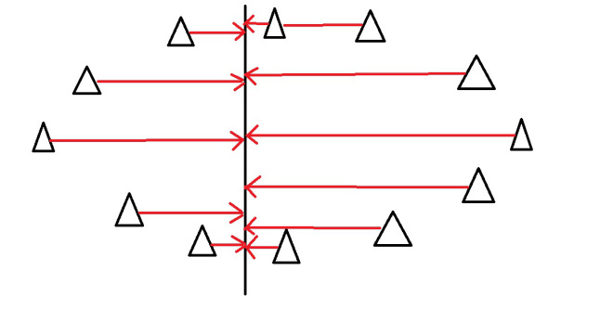
Direction where there is most variance
Imagine that the triangles are points of data. To find the direction where there is most variance, find the straight line where the data is most spread out when projected onto it. A vertical straight line with the points projected on to it will look like this:
Source: George Dallas, Principal Component Analysis 4 Dummies: Eigenvectors, Eigenvalues and Dimension Reduction.

Slide 29
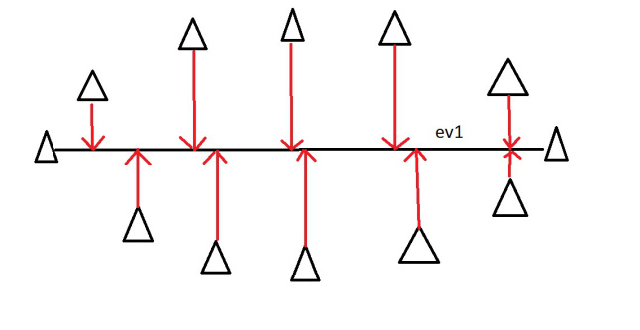
Principal Component
On this line the data is way more spread out, it has a large variance. In fact there isn’t a straight line you can draw that has a larger variance than a horizontal one. A horizontal line is therefore the principal component in this example.
Source: George Dallas, Principal Component Analysis 4 Dummies: Eigenvectors, Eigenvalues and Dimension Reduction.

Slide 30
Eigenvectors and eigenvalues
Eigenvectors and values exist in pairs: every eigenvector has a corresponding eigenvalue.
An eigenvector is a direction, in the previous example the eigenvector was the direction of the line (vertical, horizontal, 45 degrees etc.).
An eigenvalue is a number, telling you how much variance there is in the data in that direction.
In the previous example the eigenvalue is a number telling us how spread out the data is on the line. The eigenvector with the highest eigenvalue is therefore the principal component.
Source: George Dallas, Principal Component Analysis 4 Dummies: Eigenvectors, Eigenvalues and Dimension Reduction.

Slide 31
Dimensions and eigenvectors
The amount of eigenvectors/values that exist equals the number of dimensions the data set has.
For example, if we measuring age and hours on the internet. there are 2 variables, it’s a 2 dimensional data set, therefore there are 2 eigenvectors/values.
If we measure age, hours on internet and hours on mobile phone there’s 3 variables, 3-D data set, so 3 eigenvectors/values.
The reason for this is that eigenvectors put the data into a new set of dimensions, and these new dimensions have to be equal to the original amount of dimensions.
Source: George Dallas, Principal Component Analysis 4 Dummies: Eigenvectors, Eigenvalues and Dimension Reduction.

Slide 32
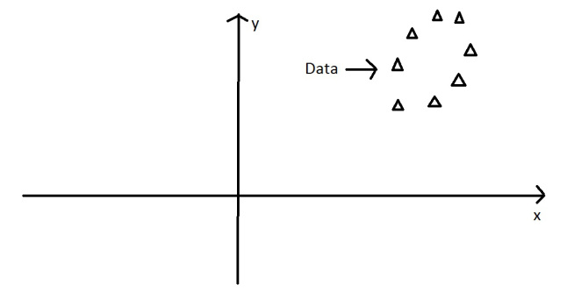
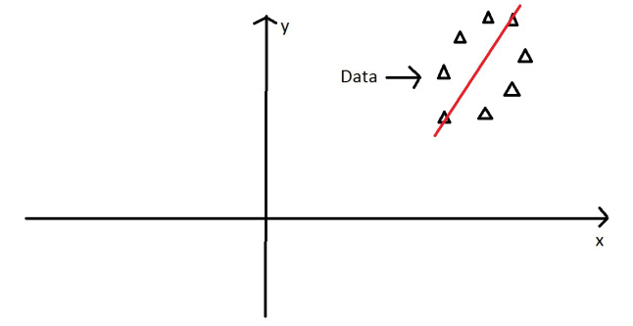
A 2D example
The oval is on an x-y axis. x could be age and y hours on the internet. These are the two dimensions that the data set is currently being measured in.
The principal component of the oval was a line splitting it long ways.
Source: George Dallas, Principal Component Analysis 4 Dummies: Eigenvectors, Eigenvalues and Dimension Reduction.

Slide 33
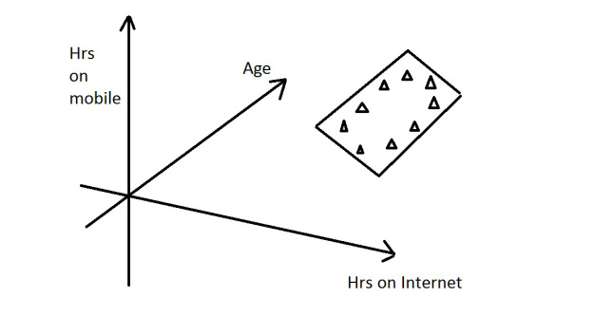
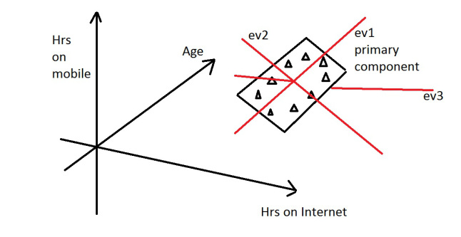
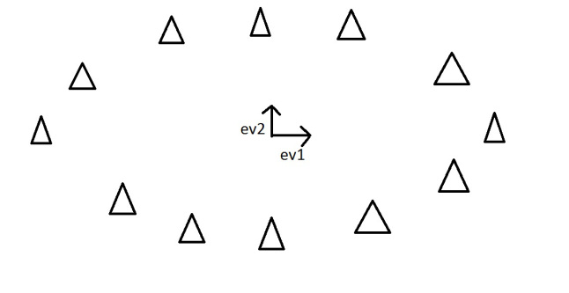
Dimension Reduction
PCA can be used to reduce the dimensions of a data set.
Dimension reduction reduces the data down into it’s basic components, stripping away any unnecessary parts.
Source: George Dallas, Principal Component Analysis 4 Dummies: Eigenvectors, Eigenvalues and Dimension Reduction.

Slide 34
Encoding categorical features
Often features are not given as continuous values but categorical.
For example a person could have features ["male", "female"], ["from Europe", "from US", "from Asia"], ["uses Firefox", "uses Chrome", "uses Safari", "uses Internet Explorer"].
Such features can be efficiently coded as integers, for instance ["male", "from US", "uses Internet Explorer"] could be expressed as [0, 1, 3] while ["female", "from Asia", "uses Chrome"] would be [1, 2, 1].

Slide 35
Encoding categorical features
Such integer representation can not be used directly with scikit-learn estimators, as these expect continuous input, and would interpret the categories as being ordered, which is often not desired (i.e. the set of browsers was ordered arbitrarily).
One possibility to convert categorical features to features that can be used with scikit-learn estimators is to use a one-of-K or one-hot encoding, which is implemented in OneHotEncoder.
This estimator transforms each categorical feature with m possible values into m binary features, with only one active.

Slide 36
Encoding categorical features
By default, how many values each feature can take is inferred automatically from the dataset.
It is possible to specify this explicitly using the parameter n_values.
There are two genders, three possible continents and four web browsers in our dataset. Then we fit the estimator, and transform a data point.
In the result, the first two numbers encode the gender, the next set of three numbers the continent and the last four the web browser.

Slide 37
OneHotEncoder
The input to this transformer should be a matrix of integers, denoting the values taken on by categorical (discrete) features.
The output will be a sparse matrix where each column corresponds to one possible value of one feature.
It is assumed that input features take on values in the range [0, n_values).
This encoding is needed for feeding categorical data to many scikit-learn estimators, notably linear models and SVMs with the standard kernels.

Slide 38
OneHotEncoder- example

Slide 39
OneHotEncoder
This works very well with most machine learning algorithms. Some algorithms, such as random forests, handle categorical values natively. Then, one hot encoding is not necessary.
The process of one hot encoding may seem tedious, but most modern machine learning libraries can take care of it.
Source: Håkon Hapnes Strand, https://www.quora.com/What-is-one-hot-encoding-and-when-is-it-used-in-data-science

Slide 40
Imputation of missing values
For various reasons, many real world datasets contain missing values, often encoded as blanks, NA or other placeholders.
Such datasets however are incompatible with scikit-learn estimators which assume that all values in an array are numerical, and that all have and hold meaning.
A basic strategy to use incomplete datasets is to discard entire rows and/or columns containing missing values.
However, this comes at the price of losing data which may be valuable (even though incomplete).
A better strategy is to impute the missing values, i.e., to infer them from the known part of the data.

Slide 41
The Imputer class (in Python)
The Imputer class provides basic strategies for imputing missing values, either using the mean, the median or the most frequent value of the row or column in which the missing values are located.
This class also allows for different missing values encodings.
strategy : string, optional (default=”mean”)
The imputation strategy.
If “mean”, then replace missing values using the mean along the axis.
If “median”, then replace missing values using the median along the axis.
If “most_frequent”, then replace missing using the most frequent value along the axis.

Slide 42
Feature selection
The classes in the sklearn.feature_selection module can be used for feature selection/dimensionality reduction on sample sets, either to improve estimators’ accuracy scores or to boost their performance on very high-dimensional datasets.

Slide 43
Removing features with low variance
VarianceThreshold is a simple baseline approach to feature selection.
It removes all features whose variance doesn’t meet some threshold. By default, it removes all zero-variance features, i.e. features that have the same value in all samples.

Slide 44
If you have any questions
Please feel free to come and see me (9th Floor, Sir Michael Uren Research Hub, White City Campus) or email (p.barnaghi@imperial.ac.uk).

